Slide 1

Seasonal Agricultural Performance Analysis
Avi Anant
AMC Engineering College
AICTE STU ID : STU6a6b26d41ecf51785407188

Slide 2

PROBLEM STATEMENT
Agricultural activities are influenced by seasonal variations in environmental conditions, farming practices, resource availability and market conditions. As a result, agricultural performance may differ from one season to another.
However, raw agricultural data does not clearly explain how agricultural performance changes across seasons or what patterns can be observed in different seasonal conditions.
The problem is to analyze the given agricultural dataset and investigate seasonal differences in agricultural performance by identifying meaningful patwithin the available dataterns, trends, relationships and variations .

Slide 3
Project Description
This project analyzes agricultural data collected across different seasons, regions and farming conditions. The analysis focuses on agricultural performance, environmental conditions, farming practices, resource usage and economic outcomes. Data analysis and visualization are used to identify seasonal patterns, compare performance, examine relationships and understand significant differences in the data. The findings are used to develop meaningful conclusions and support better seasonal agricultural planning.

Slide 4

WHO ARE THE END USERS?
Farmers
Agricultural planners
Agricultural researchers
Government and agricultural organizations
Data analysts and decision-maker

Slide 5

Technology Used
  Python
  Google Colab / Jupyter Notebook
  Pandas
  NumPy
  Matplotlib
  Seaborn

Slide 6
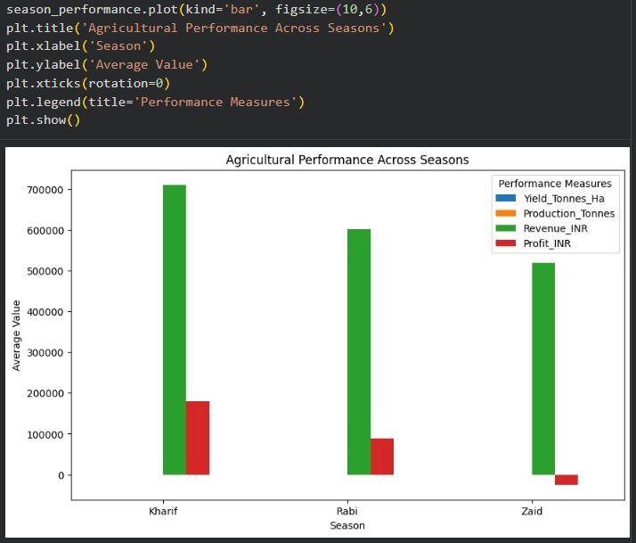
RESULTS

Slide 7
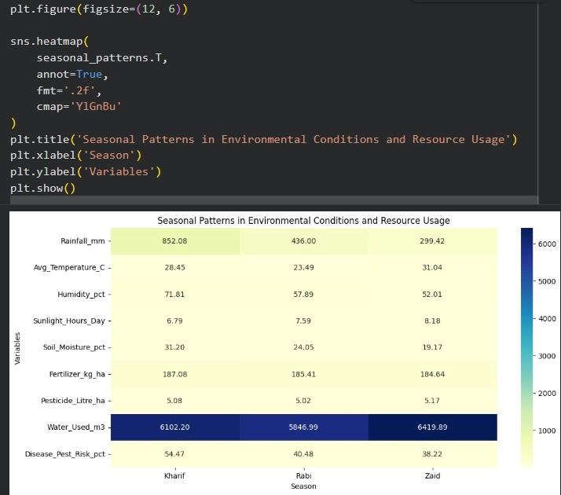
RESULTS

Slide 8
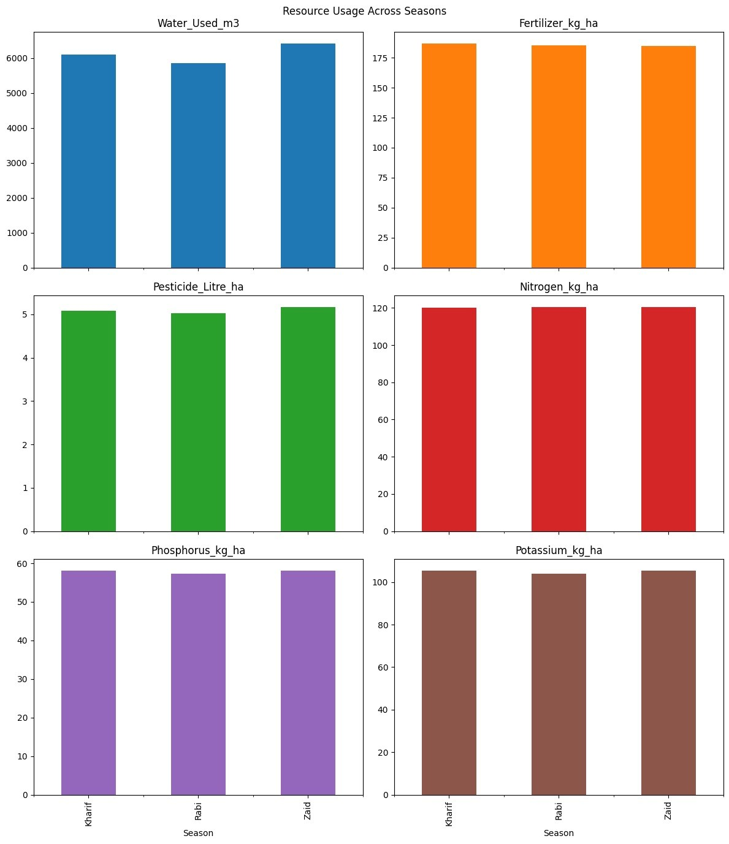
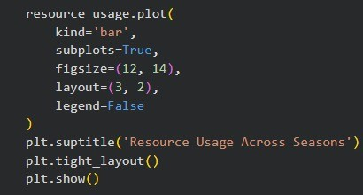
RESULTS

Slide 9
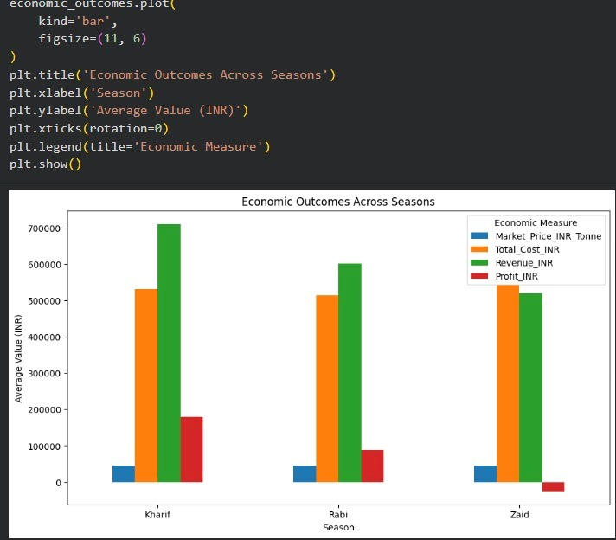
RESULTS

Slide 10
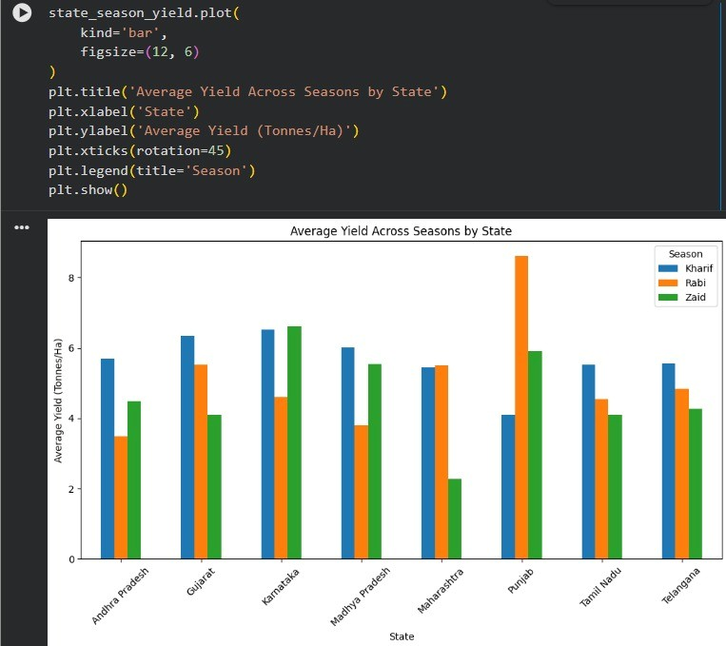
RESULTS

Slide 11
Future scope
Develop more detailed seasonal agricultural analysis.
Include additional environmental and agricultural factors.
Perform deeper analysis across different regions and categories.
Use advanced statistical and visualization techniques.
Support better seasonal agricultural planning.

Slide 12
GitHub Link
https://github.com/dev-avi09/Seasonal_Agricultural_Performance_Analysis

Slide 13
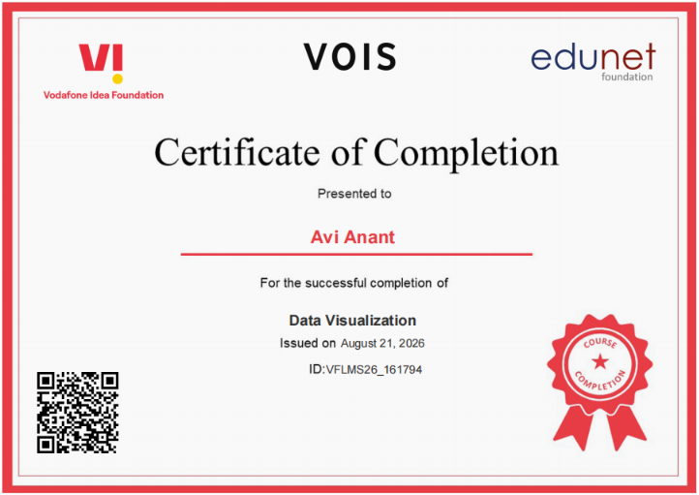
VOIS Course completion certificate -
Course name- Data Visualization

Slide 14
Thank you
.
.

